Slide 1
Unit 4: Testing
Fundamentals of testing
Levels of testing
Test cases
Black box testing techniques
White box testing techniques
Introduction to selenium : Feature of selenium, Versions of selenium, Record and play back

Slide 2
How do you test a program?
Input test data to the program.
Observe the output:
  Check if the program behaved as expected.

Slide 3



How do you test a system?

Slide 4
How do you test a system?
If the program does not behave as expected:
  note the conditions under which it failed.
  later debug and correct.

Slide 5
Question
Which type of testing is done at client end?
Alpha testing
Beta testing
Unit testing
Integrated testing

Slide 6
Error, Faults, and Failures
A failure is a manifestation of an error (aka defect or bug).
  mere presence of an error may not lead to a failure.

Slide 7
Error, Faults, and Failures
A fault is an incorrect state entered during program execution:
  a variable value is different from what it should be.
  A fault may or may not not lead to a failure.

Slide 8
Test cases and Test suites
Test a software using a set of carefully designed test cases:
  the set of all test cases is called the test suite

Slide 9
Test cases and Test suites
A test case is a triplet [I,S,O]
  I is the data to be input to the system,
  S is the state of the system at which the data will be input,
  O is the expected output of the system.

Slide 10
Question
Which of the following is not part of the Test type?
Functional testing
Statement testing
Unit testing
System testing

Slide 11
Verification versus Validation
Verification is the process of determining:
  whether output of one phase of development conforms to its previous phase.
Validation is the process of determining
  whether a fully developed system conforms to its SRS document.

Slide 12
Verification versus Validation
Verification is concerned with phase containment of errors,
  whereas the aim of validation is that the final product be error free.

Slide 13
Design of Test Cases
Exhaustive testing of any non-trivial system is impractical:
  input data domain is extremely large.
Design an optimal test suite:
  of reasonable size and
  uncovers as many errors as possible.

Slide 14
Design of Test Cases
If test cases are selected randomly:
  many test cases would not contribute to the significance of the test suite,
  would not detect errors not already being detected by other test cases in the suite.
Number of test cases in a randomly selected test suite:
  not an indication of effectiveness of testing.

Slide 15
Design of Test Cases
Testing a system using a large number of randomly selected test cases:
  does not mean that many errors in the system will be uncovered.
Consider an example for finding the maximum of two integers x and y.

Slide 16
Design of Test Cases
The code has a simple programming error:
If (x>y) max = x;
else max = x;
test suite {(x=3,y=2);(x=2,y=3)} can detect the error,
a larger test suite {(x=3,y=2);(x=4,y=3); (x=5,y=1)} does not detect the error.

Slide 17
Design of Test Cases
Systematic approaches are required to design an optimal test suite:
  each test case in the suite should detect different errors.

Slide 18
Design of Test Cases
There are essentially two main approaches to design test cases:
  Black-box approach
  White-box (or glass-box) approach

Slide 19
Question
A failure is a manifestation of an____
a)Error
b)Fault
c)Both a and b
d)None of above

Slide 20
Testing Levels
Software products are tested at three levels:
  Unit testing
  Integration testing
  System testing

Slide 21
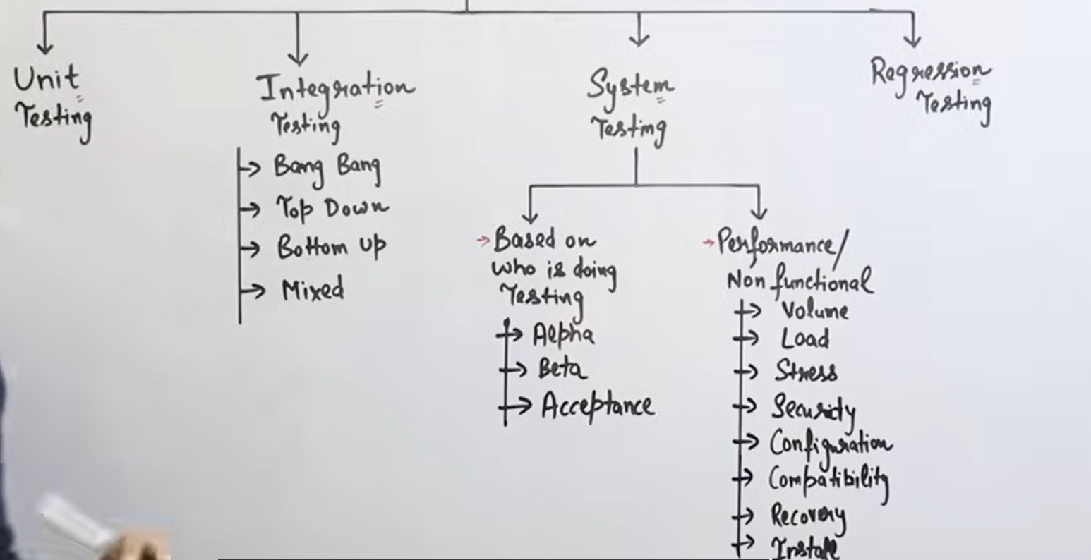

Slide 22
4 levels : Comes from SDLC model
Level 1 : Coding and Development Phase
Very small unit,module, function, smallest element of program
Level 2 : Testing Phase
Level 3 : Testing Phase
Level 4 : Maintenance Phase

Slide 23
Approaches to define test cases
Black box testing: without testing internal structure
White box testing

Slide 24
Unit testing
During unit testing, modules are tested in isolation:
  If all modules were to be tested together:
    it may not be easy to determine which module has the error.

Slide 25
Unit testing
Unit testing reduces debugging effort several folds.
  Programmers carry out unit testing immediately after they complete the coding of a module.

Slide 26
Integration testing
After different modules of a system have been coded and unit tested:
  modules are integrated in steps according to an integration plan
  partially integrated system is tested at each integration step.

Slide 27
System Testing
System testing involves:
  validating a fully developed system against its requirements.

Slide 28
Integration Testing
Develop the integration plan by examining the structure chart :
  big bang approach
  top-down approach
  bottom-up approach
  mixed approach

Slide 29
Big bang Integration Testing
Big bang approach is the simplest integration testing approach:
  all the modules are simply put together and tested.
  this technique is used only for very small systems.

Slide 30
Big bang Integration Testing
Main problems with this approach:
  if an error is found:
    it is very difficult to localize the error
    the error may potentially belong to any of the modules being integrated.
  debugging errors found during big bang integration testing are very expensive to fix.

Slide 31
Bottom-up Integration Testing (Paytm)
Integrate and test the bottom level modules first.
A disadvantage of bottom-up testing:
  when the system is made up of a large number of small subsystems.
  This extreme case corresponds to the big bang approach.

Slide 32
Top-down integration testing
Top-down integration testing starts with the main routine:
  and one or two subordinate routines in the system.
After the top-level 'skeleton’ has been tested:
  immediate subordinate modules of the 'skeleton’ are combined with it and tested.

Slide 33
Mixed integration testing
Mixed (or sandwiched) integration testing:
  uses both top-down and bottom-up testing approaches.
  Most common approach

Slide 34
Mixed Integration Testing
In top-down approach:
  testing waits till all top-level modules are coded and unit tested.
In bottom-up approach:
  testing can start only after bottom level modules are ready.

Slide 35
Question
In which type of Integration testing all the modules are integrated at once ?
  big bang approach
  top-down approach
  bottom-up approach
  mixed approach

Slide 36
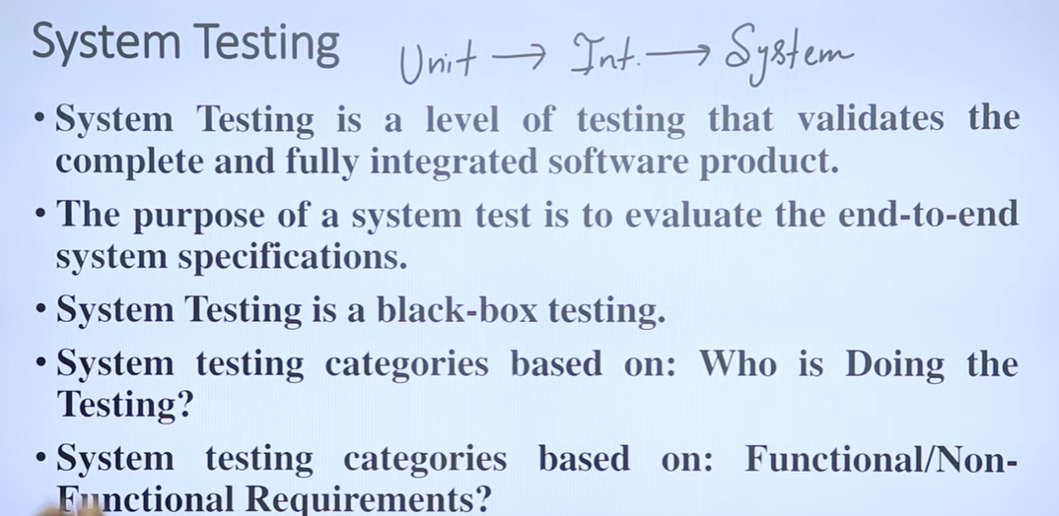

Slide 37
System Testing
There are three main kinds of system testing:
  Alpha Testing
  Beta Testing
  Acceptance Testing

Slide 38
Alpha Testing
System testing is carried out by the test team within the developing organization.

Slide 39
Beta Testing
System testing performed by a select group of friendly customers.

Slide 40
Acceptance Testing
System testing performed by the customer himself:
  to determine whether the system should be accepted or rejected.

Slide 41
Performance Testing
Performance testing is carried out to check whether the system meets the non-functional requirements identified in the SRS document.
Checking at an extreme cases.

Slide 42
Question
Which testing is performed by the customer himself?
  Alpha Testing
  Beta Testing
  Acceptance Testing
  None of above

Slide 43
Stress Testing
Stress testing (aka endurance testing):
  impose abnormal input to stress the capabilities of the software.
  Input data volume, input data rate, processing time, utilization of memory, etc. are tested beyond the designed capacity.

Slide 44
Volume Testing
Addresses handling large amounts of data in the system:
  whether data structures (e.g. queues, stacks, arrays, etc.) are large enough to handle all possible situations
  Fields, records, and files are stressed to check if their size can accommodate all possible data volumes.

Slide 45
Configuration Testing
Analyze system behavior:
  in various hardware and software configurations specified in the requirements
  sometimes systems are built in various configurations for different users
  for instance, a minimal system may serve a single user,
    other configurations for additional users.

Slide 46
Compatibility Testing
These tests are needed when the system interfaces with other systems:
  check whether the interface functions as required.

Slide 47
Recovery Testing
These tests check response to:
  presence of faults or to the loss of data, power, devices, or services
  subject system to loss of resources
    check if the system recovers properly.

Slide 48
Maintenance Testing
Verify that:
  all required artifacts for maintenance exist
  they function properly

Slide 49
Documentation tests
Check that required documents exist and are consistent:
  user guides,
  maintenance guides,
  technical documents

Slide 50
Documentation tests
Sometimes requirements specify:
  format and audience of specific documents
  documents are evaluated for compliance

Slide 51
Usability tests
All aspects of user interfaces are tested:
  Display screens
  messages
  report formats
  navigation and selection problems

Slide 52
Regression Testing
Does not belong to either unit test, integration test, or system test.
  In stead, it is a separate dimension to these three forms of testing.

Slide 53
Regression testing
Regression testing is the running of test suite:
  after each change to the system or after each bug fix
  ensures that no new bug has been introduced due to the change or the bug fix.

Slide 54
Regression testing
Regression tests assure:
  the new system’s performance is at least as good as the old system
  always used during phased system development.

Slide 55
Black-box Testing
Test cases are designed using only functional specification of the software:
  without any knowledge of the internal structure of the software.
For this reason, black-box testing is also known as functional testing.

Slide 56
White-box Testing
Designing white-box test cases:
  requires knowledge about the internal structure of software.
  white-box testing is also called structural testing.
  In this unit we will not study white-box testing.

Slide 57
Black-box Testing
There are essentially two main approaches to design black box test cases:
  Equivalence class partitioning
  Boundary value analysis

Slide 58
Question
Which of the following testing is also known as white-box testing?
Structure Testing
Functional testing
Design based testing
None of above

Slide 59
Equivalence Class Partitioning
Input values to a program are partitioned into equivalence classes.
Partitioning is done such that:
  program behaves in similar ways to every input value belonging to an equivalence class.

Slide 60
Why define equivalence classes?
Test the code with just one representative value from each equivalence class:
  as good as testing using any other values from the equivalence classes.

Slide 61
Equivalence Class Partitioning
How do you determine the equivalence classes?
  examine the input data.
  few general guidelines for determining the equivalence classes can be given

Slide 62
Equivalence Class Partitioning
If the input data to the program is specified by a range of values:
  e.g. numbers between 1 to 5000.
  one valid and two invalid equivalence classes are defined.
1
5000

Slide 63
Equivalence Class Partitioning
If input is an enumerated set of values:
  e.g. {a,b,c}
  one equivalence class for valid input values
  another equivalence class for invalid input values should be defined.

Slide 64
Example
A program reads an input value in the range of 1 and 5000:
  computes the square root of the input number
SQRT

Slide 65
Example (cont.)
There are three equivalence classes:
  the set of negative integers,
  set of integers in the range of 1 and 5000,
  integers larger than 5000.
1
5000

Slide 66
Example (cont.)
The test suite must include:
  representatives from each of the three equivalence classes:
  a possible test suite can be:
  {-5,500,6000}.
5000
1

Slide 67
Boundary Value Analysis
Some typical programming errors occur:
  at boundaries of equivalence classes
  might be purely due to psychological factors.
Programmers often fail to see:
  special processing required at the boundaries of equivalence classes.

Slide 68
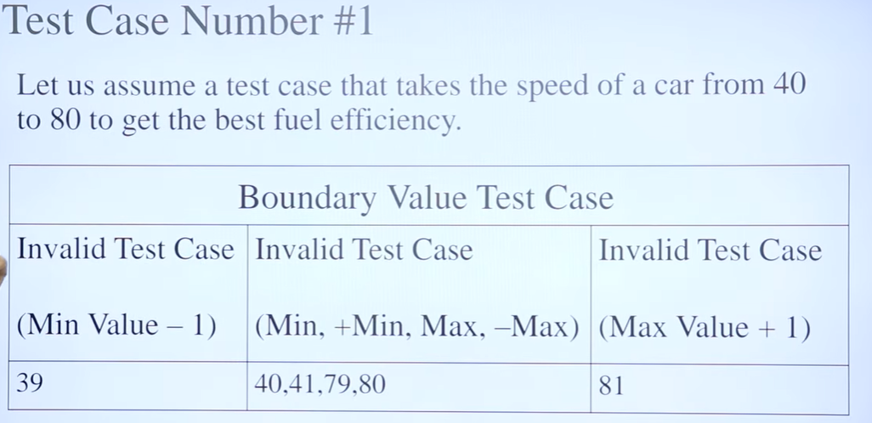

Slide 69
Boundary Value Analysis
Programmers may improperly use < instead of <=
Boundary value analysis:
  select test cases at the boundaries of different equivalence classes.

Slide 70
Example
For a function that computes the square root of an integer in the range of 1 and 5000:
  test cases must include the values: {0,1,5000,5001}.
1
5000

Slide 71
Compatibility testing
Example
If a system is to communicate with a large database system to retrieve information:
  a compatibility test examines speed and accuracy of retrieval.

Slide 72
Error Seeding
Seed the code with some known errors:
  artificial errors are introduced into the program.
  Check how many of the seeded errors are detected during testing.

Slide 73
Error Seeding
Let:
  N be the total number of errors in the system
  n of these errors be found by testing.
  S be the total number of seeded errors,
  s of the seeded errors be found during testing.

Slide 74
Error Seeding
n/N = s/S
N = S*n/s
remaining defects:
N - n = n*((S - s)/ s)

Slide 75
Example
100 errors were introduced.
90 of these errors were found during testing
50 other errors were also found.
Remaining errors=
50 (100-90)/90 = 6

Slide 76
Selenium
Selenium is a leading test automation framework for web applicationsFormal Technical Review
Use multiple programming languages like Java, C#, Python etc to create Selenium Test ScriptsCode Inspection
Selenium Software is not just a single tool but a suite of software
  Selenium Integrated Development Environment (IDE)
  Selenium Remote Control (RC)
  WebDriver
  Selenium Grid

Slide 77
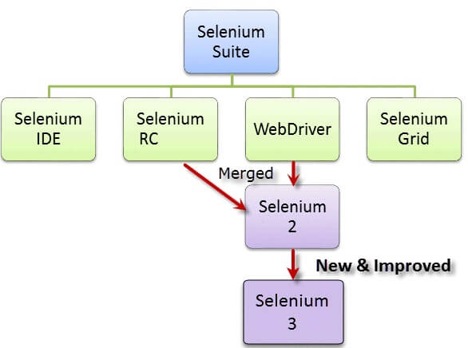
Selenium

Slide 78
Selenium
Selenium was created by Jason Huggins in 2004
He was working on a web application that required frequent testing.
He created a JavaScript program that would automatically control the browser’s actions. He named this program as the
“JavaScriptTestRunner“
He made JavaScriptRunner open-source which was later re-named as Selenium Core.

Slide 79
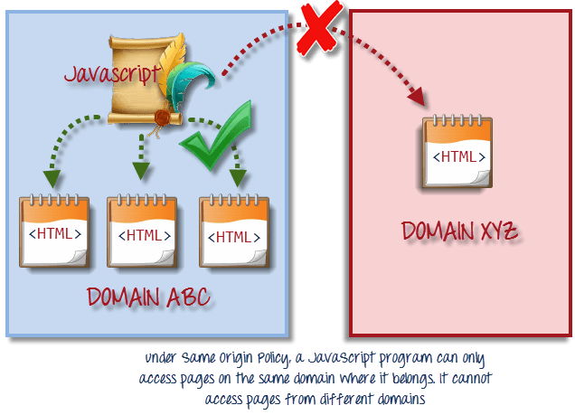
Selenium
Issue with the Selenium core
Same Origin policy prohibits JavaScript code from accessing elements from a domain that is different from where it was launched.

Slide 80
Selenium
Selenium Remote Control
Testers using Selenium Core had to install the whole application under test and the web server on their own local computers because of the restrictions imposed by the same origin policy.
Paul Hammant, decided to create a server that will act as an HTTP proxy to “trick” the browser into believing that Selenium Core and the web application being tested come from the same domain.
his system became known as the Selenium Remote Control or Selenium 1

Slide 81
Selenium
Selenium Grid
Selenium Grid was developed by Patrick Lightbod
To address the need of minimizing test execution times as much as possible.
He initially called the system “Hosted QA.”
It captures the browser screenshots during significant stages,

